Slide 1
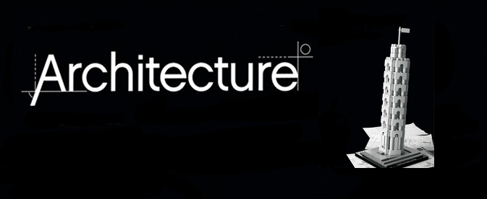
Software Architecture and Software Architect
T-Systems RUS. JavaSchool
Saint-Petersburg, July’15
Sergey N Lukin
Notes:
Update 19/03/2014
Updated 12/11/2014
Version 28/08/2014
Version 21/07/2015 – fonts
Version 22/07/2015 – architecture depends on…

Slide 2
Intro
0
Introduction
1
Questions
2
Terms
3
Simplification
Notes:
1. @me
2. В каждом разделе есть время для вопросов. В конце есть общая секция для вопросов. Если в аудитории мало человек – то можно прерывать.
3. Я часто буду путать слова «продукт / решение / программа / проект» - для данной презентации считайте что это практически синонимы.
4. Все примеры приведенные будут максимально упрощены, т.к. на реальные примеры 2 часов явно не достаточно. Некоторые тезисы, которые я буду доносить могут носить спорный характер, как в общем и многое в архитектуре в целом. (все зависит от точек зрения и ожиданий)
5. Для иллюстраций я буду использовать UML, если у вас возник вопрос по нотации, прерывайте я поясню. Возможно что я использую не очень популярные аспекты нотаций.

Slide 3
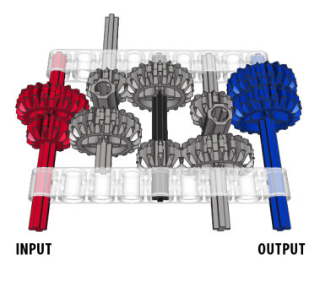
Agenda
Content
0
Intro
1
Basic design principles
2
Design example
3
Multilayered architecture
4
Architect role in PLC
Notes:
PLC – product life cycle
RM –req. management
Introduction
Basic design principles
Design example (from req to classes)
перерыв
Multilayered architecture (+ some words about Jee)
Или тут перерыв (посмотрим по таймингу)
Architect role in PLC
Again Multilayered architecture

Slide 4

Why we need Architects?
I know Java and SQL, why I need Architect for our product?
Notes:
Ask audience, why we need architects.
Small discussion

Slide 5
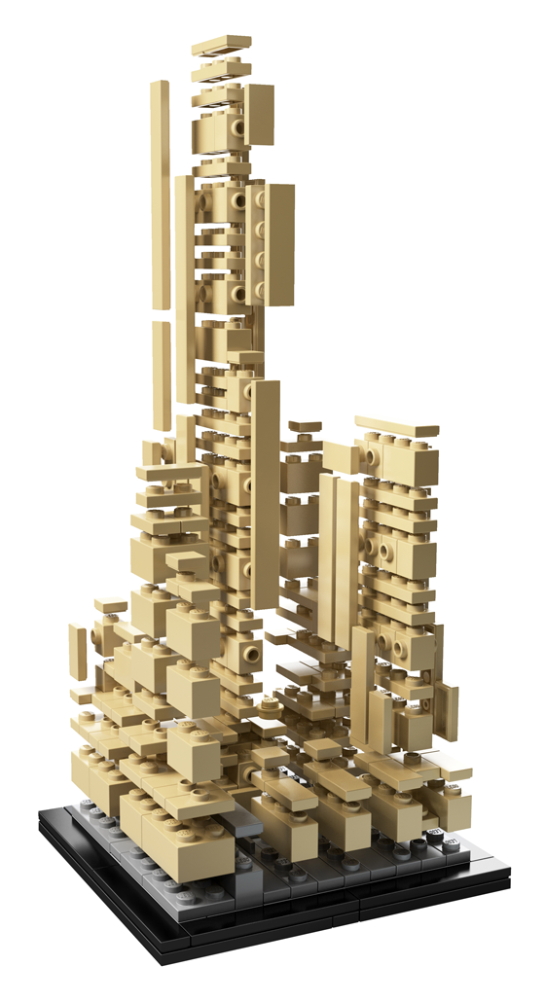

Why we need Architects? Short Answer.
I know Java and SQL, why I need Architect for our product?
Because your product has Architecture.
Notes:
Переход к сл. Слайду
Разные продукты- разные архитектуры

Slide 6

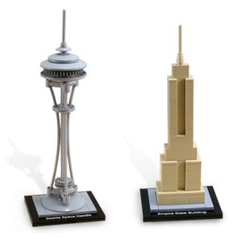
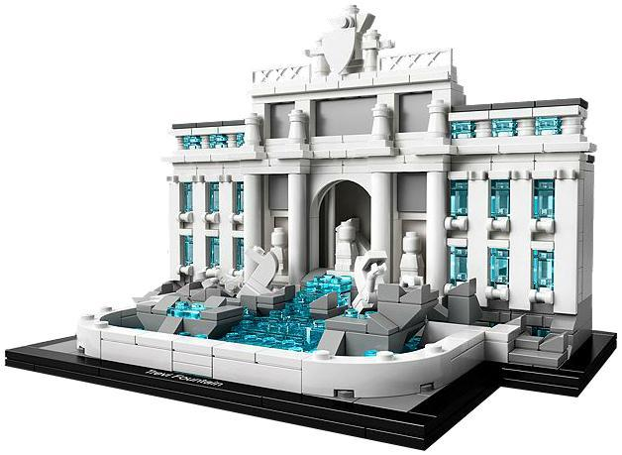
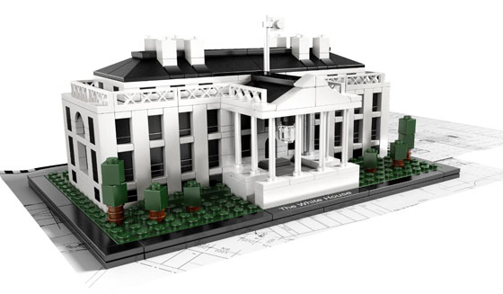
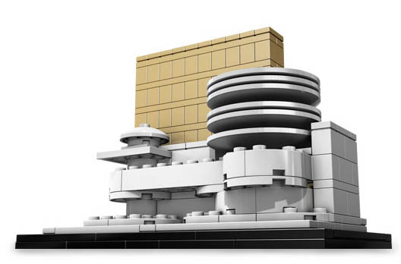
Different architectures
Notes:
So we have different System architectures.

Slide 7
Outer Function requirements
Notes:
Of course system depend on requirements from our external Stakeholders
Example: UI layer as result of requirement to operate with data in application

Slide 8
Outer quality attributes
Notes:
Performance
Volume

Slide 9
Our internal functional requirements
Notes:
Monitoring
Logging
Internal admin tools

Slide 10
Our internal quality requirements
Notes:
Расширяемость
Тестопригодность

Slide 11
Design Guidlines
Notes:
Guidelines – кровью пишутся.
CDDM / CSDG
Patterns: factory / singleton
Príncipes

Slide 12
Resources
Notes:
time, people, money, partners, trust, risks

Slide 13
Personal pain experience
Notes:
Personality in design

Slide 14
Development team

Slide 15
Company restriction
Notes:
D4
Technologies stack
Open source software
Слияние, поглощение

Slide 16
Architecture depends on
Notes:
Conway law
Organizations which design systems ... are constrained to produce designs which are copies of the communication structures of these organizations

Slide 17
Architecture depends on
Notes:
integration landscape, locked-in vendors

Slide 18
But outer requirement is more important
Notes:
Но не надо забывать что внешние требования все равно основной драйвер, и в первую очеред именно по ним будет оцениваться работа.
Переход к качеству архитектуры
Ес-но, мы хотим что наш продукт был хорошим (а лучше отличным) и поэтому нам просто необходима хорошая архитектура продукта.

Slide 19
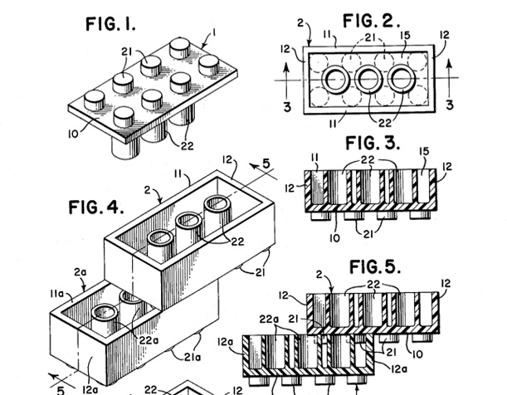
What means good architecture?
Quality attributes
Meet requirements
Ready for change
Ready for scaling and distribution
Minimize cost
Other NFR
Notes:
Качество архитектуры неразрывно связано с качеством продукта/приложения.
Поэтому хорошая архитектура приложения которая: обеспечивает реализацию всех требования и целей которые ставились перед приложением. (пояснение какая бы не была красива архитектура, если приложение построенное по ней не работает, то…)
Архитектура должна обеспечивать ожидаемую гибкость по развитию продукта. (примеры: добавление языка, или семейный тип билета, или добавление прицепа к фуре). (включает в себя как быстро новая команда сможет разобраться в продукте)
Архитектура должна позволить масштабировать решение.
Архитектура приложения должна минимизировать стоимость создания и поддержки. За счет reuse, clear structure, easy debugging, stability.
Other NFR – Supportability, Reuse this application, easy to integration in future, standards,

Slide 20
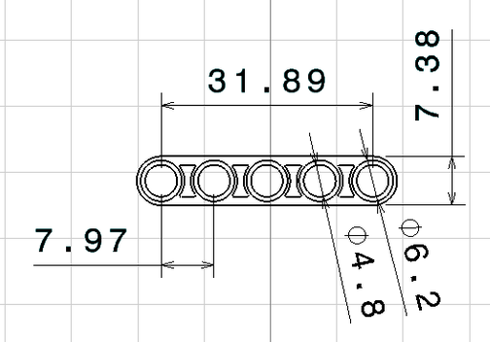
ISO 9126 Software quality
Quality attributes
Functionality
Reliability
Usability
Efficiency
Maintainability
Portability
Notes:
Very similar with previous slide
Functionality - A set of attributes that bear on the existence of a set of functions and their specified properties. The functions are those that satisfy stated or implied needs.
Suitability
Accuracy
Interoperability
Security
Functionality Compliance
Reliability - A set of attributes that bear on the capability of software to maintain its level of performance under stated conditions for a stated period of time.
Maturity
Fault Tolerance
Recoverability
Reliability Compliance
Usability - A set of attributes that bear on the effort needed for use, and on the individual assessment of such use, by a stated or implied set of users.
Understandability
Learnability
Operability
Attractiveness
Usability Compliance
Efficiency - A set of attributes that bear on the relationship between the level of performance of the software and the amount of resources used, under stated conditions.
Time Behavior
Resource Utilization
Efficiency Compliance
Maintainability - A set of attributes that bear on the effort needed to make specified modifications.
Analyzability
Changeability
Stability
Testability
Maintainability Compliance
Portability - A set of attributes that bear on the ability of software to be transferred from one environment to another.
Adaptability
Installability
Co-Existence
Replaceability
Portability Compliance

Slide 21
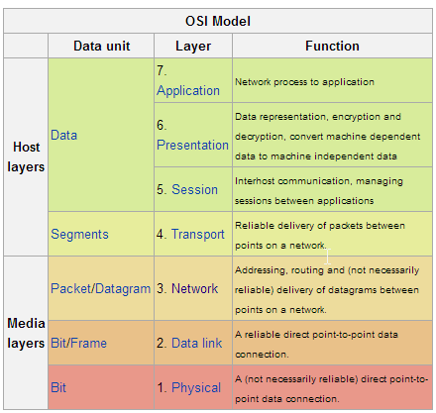
Key architecture principles and practice
Principles
Separation of concerns.
Single Responsibility principle.
Principle of Least Knowledge.
Don’t repeat yourself (DRY).
Notes:
Separation of concerns - Divide your application into distinct features with as little overlap in functionality as possible. The important factor is minimization of interaction points to achieve high cohesion and low coupling. However, separating functionality at the wrong boundaries can result in high coupling and complexity between features even though the contained functionality within a feature does not significantly overlap.
Example OSI model. Patterns: Information Expert, Creator, Mediator
Single Responsibility principle. Each component or module should be responsible for only a specific feature or functionality, or aggregation of cohesive functionality.
It is bad to have component which include two responsibility, because it is two reason to change it. Good example SOA – term Service.
Principle of Least Knowledge (also known as the Law of Demeter or LoD). A component or object should not know about internal details of other components or objects.
Example: Interface
Don’t repeat yourself (DRY). You should only need to specify intent in one place. For example, in terms of application design, specific functionality should be implemented in only one component; the functionality should not be duplicated in any other component.
Microsoft Application Architecture Guide, 2nd Edition
Разделение функций. Разделите приложение на отдельные компоненты с, по
возможности, минимальным перекрытием функциональности. Важным фактором
является предельное уменьшение количества точек соприкосновения, что
обеспечит высокую связность (high cohesion) и слабую связанность (low coupling).
Неверное разграничение функциональности может привести к высокой связанности
и сложностям взаимодействия, даже несмотря на слабое перекрытие
функциональности отдельных компонентов.
Принцип единственности ответственности. Каждый отдельно взятый компонент
или модуль должен отвечать только за одно конкретное свойство/функцию или
совокупность связанных функций.
• Принцип минимального знания (также известный как Закон Деметера (Law of
Demeter, LoD)). Компоненту или объекту не должны быть известны внутренние
детали других компонентов или объектов.
• Не повторяйтесь (Don’t repeat yourself, DRY). Намерение должно быть обозначено
только один раз. В применении к проектированию приложения это означает, что
определенная функциональность должна быть реализована только в одном
компоненте и не должна дублироваться ни в одном другом компоненте.

Slide 22
Key architecture principles and practices
Common design practices
Prefer composition to inheritance
Separate the areas of concern between layers
Be explicit about how layers communicate with each other.
Define a clear contract for components.
Keep design patterns consistent within each layer
Do not mix different types of components in the same logical layer.
Keep the data format consistent within a layer or component
A component /object should not rely on internal details of other components/objects.
Do not overload the functionality of a component.
Keep crosscutting code abstracted from the application business logic as far as possible
Establish a coding style and naming convention for development.
Maintain system quality using automated QA techniques during development.
Consider the operation of your application.

Slide 23
Key architecture principles and practices
Common design practices
Prefer composition to inheritance
Separate the areas of concern between layers
Be explicit about how layers communicate with each other.
Define a clear contract for components.
Keep design patterns consistent within each layer
Do not mix different types of components in the same logical layer.
Keep the data format consistent within a layer or component
A component /object should not rely on internal details of other components/objects.
Do not overload the functionality of a component.
Keep crosscutting code abstracted from the application business logic as far as possible
Establish a coding style and naming convention for development.
Maintain system quality using automated QA techniques during development.
Consider the operation of your application.

Slide 24
Design example
Notes:
Bellow I will show how can be organized desgin proccess in case simple application

Slide 25
Design Example: Simple Enterprise Search (SES)
Description:
SES is software of search information within an enterprise data.
Requirements (plain style):
Users from our company should be able to search across office document. Initially documents can be stored on external storages (ftp, corporative web server, windows shared folder). Also it should be possible to upload document directly to system. Only managers and dedicated persons should be able to search across finance documentation. All our user have browser Chrome on their PCs.

Slide 26
Trying to rewrite requirements
UR01. Users should be able to search accross documents.
UR02. Users can have different access right.
UR03. Document types: Word, XLS.
UR04. Web inteface should work in Chrome.
UR05. System should be able to get document via:
1. FTP
2. SAMBA
3. HTTP
UR 06. Special users can upload document directly to System
Notes:
Please communicate with stakeholder as soon as you have any question about requirements.
For example it can help avoid strange application with “maximum drivers per wagon” or “change tariff to Standard in case deleting tariff”

Slide 27
Trying to rewrite requirements
Notes:
Try to analyze dependencies between requirements
Ask for NFR if them not provided.

Slide 28
Looking for Actors
Notes:
Who will use your application?

Slide 29
Actors generalization

Slide 30
UseCase analyzes
Notes:
How they will use it?

Slide 31
UseCase analyzes. Traceability
Notes:
As we see some user requirements not covered by use cases.

Slide 32
UseCase analyzes. Traceability
Notes:
For example, requirements about access right, not directly related to user behavior.
From experience we know that any requirements with right, access, user related to set of User Management cases:
* Create, delete, update, list user
* Assign roles
* Assign groups
* Authorization / authentication / audit
All this case in most cases clear and very similar in different applications. We will hide details heir.
But our roles also use these scenarios, so we should assign them to actors.

Slide 33
UseCase analyzes. Finally

Slide 34
Activity
Notes:
In parallel very useful to start detail all use cases from user point of view.
Which actions user should perfrom to complete use case.

Slide 35
System analyses
Notes:
After analyses user scenarios we should start define how our application will support these scenarios.
In our case I use external information source to understand how usually works any search and index engines.
As you can see on slide – the process very similar with traditional pattern ETL – extract, transform, load.
Our application should extract document, transform it to clean form (ready for indexing) and update index with it.

Slide 36
System UseCases
Notes:
As result we have set of use cases which performed inside our system. And just in directly called by users.
These cases have name System use cases.
UI – hided set of user interfaces which needed for provide functionality like:
Search page
Search result page
Login page
Upload document
Define place of document
User management pages
Etc

Slide 37
System Functional decomposition
Notes:
Our next step is performing decomposition to different functional packages.
It can help us in understanding internal structure of application and also support separation of concern principle

Slide 38
System Components: A-architecture
Notes:
As we have functional packages we can define components for covering functionalities.
In simplest way – one component responcible for one package.
But if component overloaded it should be splitted.
Also spliting can be useful if you want to user standart or external components, on your own components should be glue for them.

Slide 39
System Components
Notes:
After consultation with development team we can understand how and if it possible to implement our abstract components.
In this point we can decide about technologies stack and make some prototypes

Slide 40
Application Components + Technical components
Notes:
Of course we will have some technical components, which should help us to implement NFR
(also reduce development cost)

Slide 41
Detailed Activity Diagram
Notes:
This activity diagram show same both cases as before, but added more details
Activity separated by system components.
Some important object flow shown

Slide 42
Entity Classes
Notes:
Blue – binary format, not interesting for us.
Green – persistent entity
Rest classes just DTO
In case if we will explain activity for all use cases, probably additional objects/classes will be discovered. For example for UserManagement (Users, Roles, Groups, Rights)

Slide 43
Interfaces
Notes:
It is important to understand
Each layers communicate via specified interfaces
No communication cross layer

Slide 44
Behavior classes
Notes:
Strategy pattern
(instead abstract class can be interface used)
Important:
Parser know nothing about document types
WordParser known nothing about XLS specific
Easy to extend

Slide 45
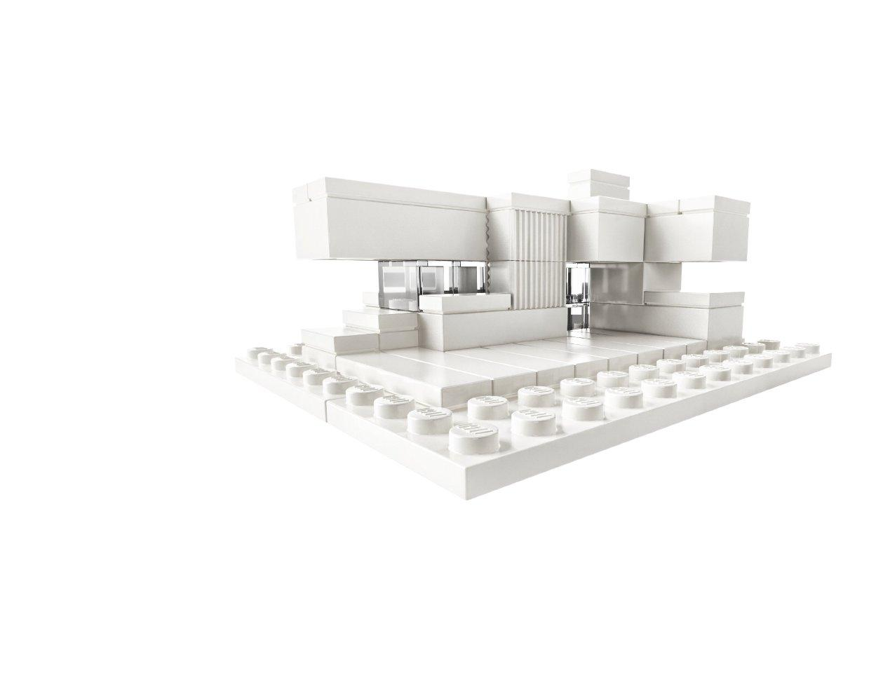
Questions?
Design example
?
Notes:
Short resume

Slide 46

Coffe
10 minutes 18:50

Slide 47
Multilayer application pattern

Slide 48
Multilayered architecture: Why?
Benefits from the box
Abstraction
Isolation
Manageability
Performance
Reusability
Testability
Notes:
Abstraction. Layers allow changes to be made at the abstract level. You can increase or decrease the level of abstraction you use in each layer of the hierarchical stack.
Isolation. Allows you to isolate technology upgrades to individual layers in order to reduce risk and minimize impact on the overall system.
Manageability. Separation of core concerns helps to identify dependencies, and organizes the code into more manageable sections.
Performance. Distributing the layers over multiple physical tiers can improve scalability, fault tolerance, and performance.
Reusability. Roles promote reusability. For example, in MVC, the Controller can often be reused with other compatible Views in order to provide a role specific or a user-customized view on to the same data and functionality.
Testability. Increased testability arises from having well-defined layer interfaces, as well as the ability to switch between different implementations of the layer interfaces. Separated Presentation patterns allow you to build mock objects that mimic the behavior of concrete objects such as the Model, Controller, or View during testing.

Slide 49
3-tier Architecture
Notes:
Presentation Layer, handle user behavior, adapt data for visualization. Can include logic for UI (for example, validation rules, screen flow rules)
Business logic - All Application functional algorithms. + Mediator between Presentation layer and Data access Layer
Data access layer – data storage and unified access methods. (at least CRUD). + Integration between Data sources

Slide 50
3-tier Architecture: our application
Notes:
Remind our application
In order to simplify, we will use abstract component model.
Question to auditory – which component will be in which layer?

Slide 51
3-tier Architecture: our application
Notes:
Remind our application

Slide 52
n-tier Architecture
Notes:
"All problems in computer science can be solved by another abstraction layer ...except for the problem of too many layers of indirection.“
Service layer – interfaces between Business and presentation, data transformation, data aggregation from different BL.
Infrastructure layer – logging, monitoring, audit.
DAL – ORM
persistence

Slide 53
n-tier Architecture: JEE
Rich application or JS/Html application
JSP / JSF / Struts / Spring MVC …
EJB
JPA + Database
Notes:
Client tier or client computer (web application or rich client)
Web tier (optional) Jee server (web container)
Business tier Jee server (ejb container)
Information Tier = Enterprise Information System Tier

Slide 54
n-tier Architecture: JEE
Notes:
Not included security aspect
It can be JAAS
Or in case Spring MVC – Spring Security.

Slide 55
Alternatives
Domain Driven Design
Specific
No strict layers
Entity and their behavior combined
Pro
Easy to extend domain model
Easy to test
Easy to map requirements
Cons
Hi- efforts/costs
Notes:
If we user DDD aspects in design our application we will another entity classes. And probably Business layer will be excluded.

Slide 56
Alternatives
Event Based
Notes:
In case Event base architecture, our Business layer can have another structure.
The root of new structure is Queues.

Slide 57
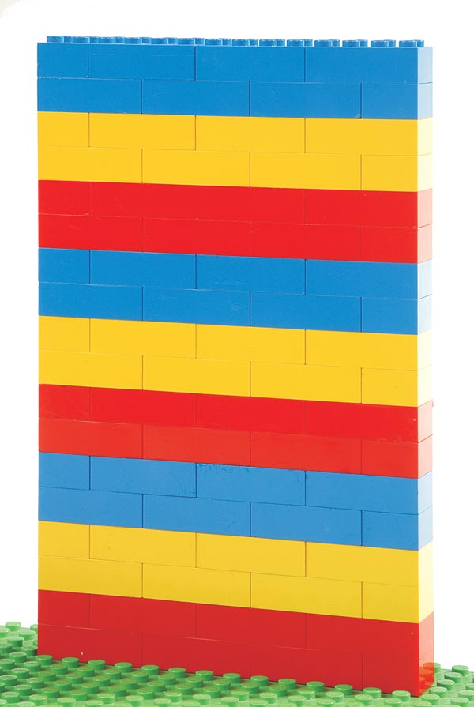
Important
Please start your enterprise application from n-tiers architecture
It is clear and easy to understand
It is proven by time
Most current EA using layered architecture
JEE designed for layered architecture
You don’t have any strong NFR
Notes:
EA == enterprise application
NFR – Non functional requirements

Slide 58

Questions?
Multilayered architecture
Notes:
Short resume

Slide 59
Coffe
15 minutes xx:xx

Slide 60
Architect Role in PLC

Slide 61
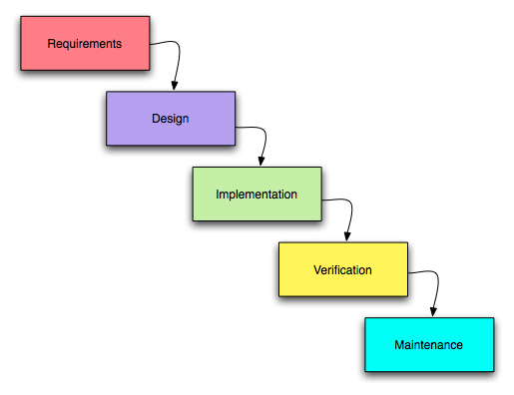
PLC Waterfall

Slide 62
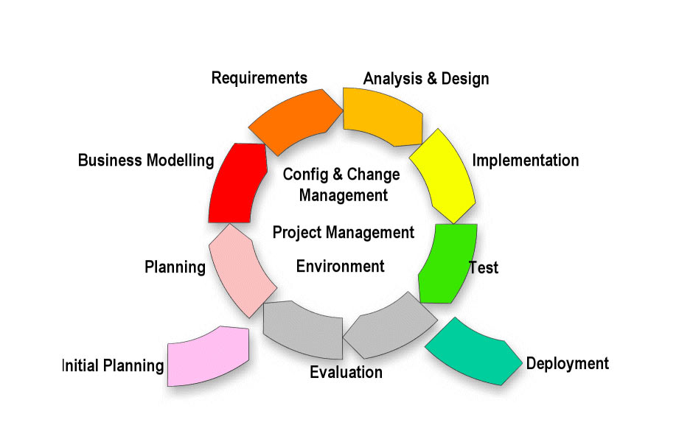
PLC RUP

Slide 63
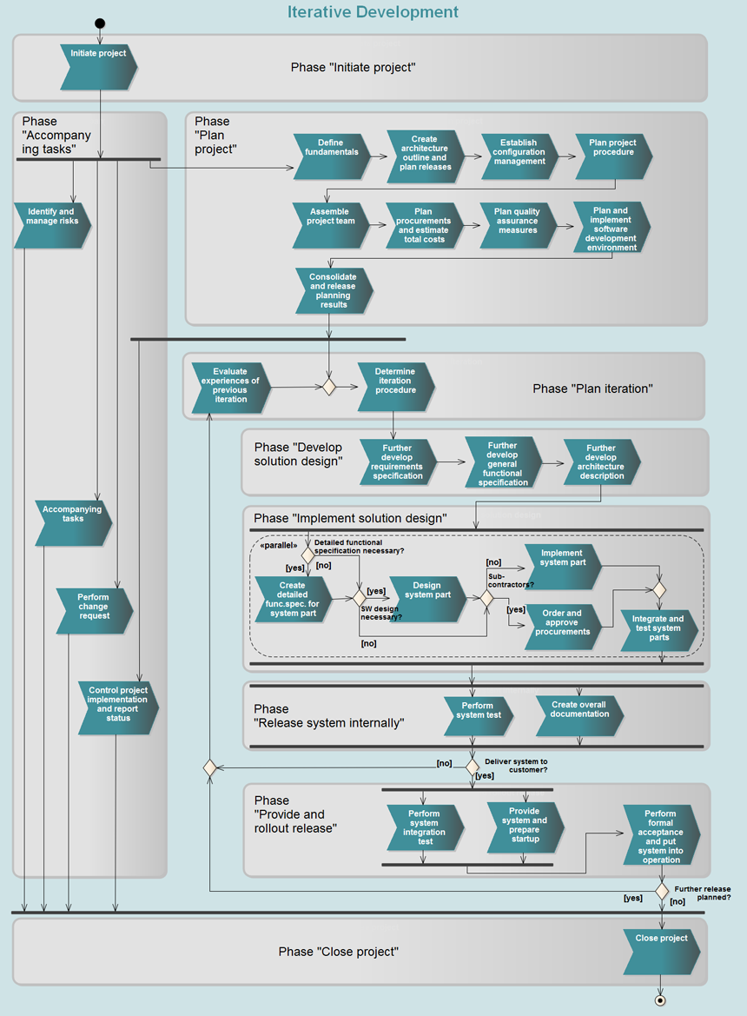
PLC SE-Book Iterative development
Details: http://sebook.t-systems.com/en/11116135a14c0b91.html
Notes:
Accompanying task includes: risk management, control and reporting, CR management
Tests included in implementation, internal release, and public release
Incremental development near to same.

Slide 64

PLC SE-Book Architect in PLC
Discussion: In which project steps Architect should be involved?

Slide 65
PLC SE-Book Architect in PLC
Short answer – Architect or Chief Architect should be involved in almost all project steps.
Notes:
Chief Architect – experienced Architect

Slide 66
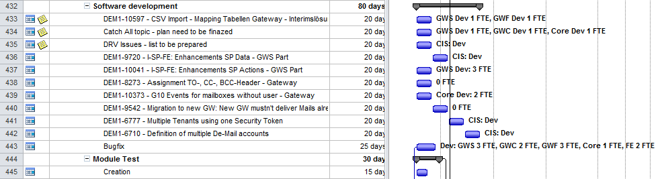
PLC SE-Book Architect tasks: Plan project
Provide effort estimation
Provide technical risks list
Validate WBS and Dependencies in Project plan
Support in Configuration management
WBS - Work Breakdown Structure
Notes:
WBS - Work Breakdown Structure
technical risks list – later small talk about risks

Slide 67
PLC SE-Book Architect tasks Requirements analyses
Support requirements development
Validate and review
System Use Cases
Requirements
GUI Prototype
Interface agreement
Traceability matrix (UC vs Req)
Logical Data Model
explained below
Notes:
RACI Responsible Accountable Consulted Informed
RASCI / RACI-VS - +Support + Verifies Signs off
Design Deployment View and Architecture of the Technical Infrastructure

Slide 68
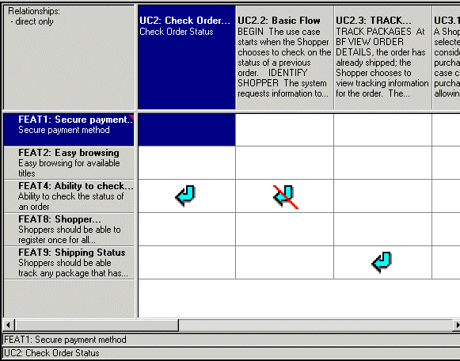
Example: Traceability Matrix Bonus
Rational RequisitePro
Notes:
Just short example for Traceability Matrix
Suspected element
Last slide about hierarchy

Slide 69
PLC SE-Book Architect tasks Develop solution design
Design:
Database
Components
Interfaces
Review
Test Plan / Test Specification
Provide/support:
Prototyping
Traceability (UC vs Comp)
Know your onions

Slide 70

PLC SE-Book Architect tasks: Implementation
Create program
Test program
Defect fixing
Ensure Code Quality
Refactoring
Align code and architecture
Yes, we can code, at least after worktime
Notes:
All Senior Dev tasks

Slide 71

PLC SE-Book Architect tasks: Test
Review test strategy
Should be involved in Critical defect analyses
We hate QA activities, but we do it.
Notes:
All Senior Dev tasks

Slide 72

PLC SE-Book Architect tasks: Rollout
Prepare Transfer to Operation
Support Productive Operation

Slide 73

PLC SE-Book Architect tasks: Close project
Determine and Analyze KPIs and Derive Measures
Notes:
KPI – key performance indicators

Slide 74
PLC SE-Book All activities should be documented
Many many documents…
Notes:
Architects time is very expensive – so we don’t have time to repeat same work again.

Slide 75
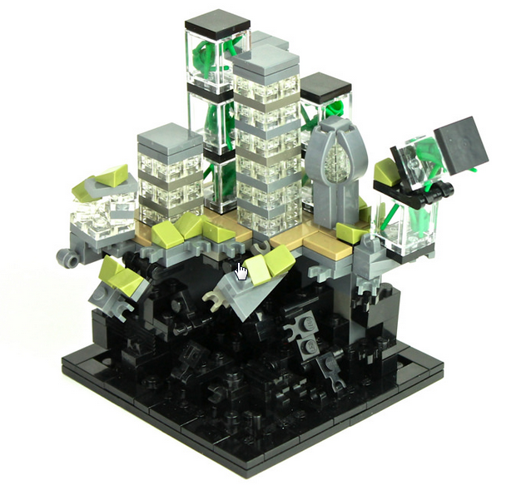
Questions?
Architect in PLC
?
Notes:
Short resume

Slide 76
Resume

Slide 77
n-tier Architecture: JEE
Notes:
Not included security aspect
It can be JAAS
Or in case Spring MVC – Spring Security.

Slide 78
Key architecture principles and practices
Common design practices
Prefer composition to inheritance
Separate the areas of concern between layers
Be explicit about how layers communicate with each other.
Keep design patterns consistent within each layer
Do not mix different types of components in the same logical layer.
Keep the data format consistent within a layer or component
A component or an object should not rely on internal details of other components or objects.
Do not overload the functionality of a component.
Keep crosscutting code abstracted from the application business logic as far as possible
Define a clear contract for components.
Establish a coding style and naming convention for development.
Maintain system quality using automated QA techniques during development.
Consider the operation of your application.
Notes:
Для ваших задач

Slide 79
Thank you!

Slide 80
References

Slide 81
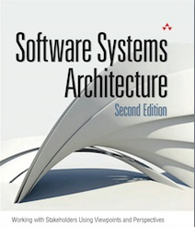
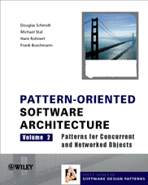


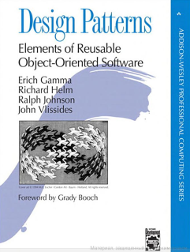
Sources
Architecture itself
Rozanski&Woods
POSA
Fowler
EIP
GOF
Notes:
Rozanski&Woods – for beginners. Many details, terms.
POSA 5 volumes many authors. At least first two volumes can be interesting (System level, concurrent problems)
Martin Fowler
Enterprise Integration Patterns: Designing, Building, and Deploying Messaging Solutions (Gregor Hohpe, Bobby Woolf)
GOF – gang of four. Erich Gamma, Richard Helm, Ralph Johnson, John Vlissides

Slide 82
Sources
Architecture practice / PLC aspects
CMMI® for Development, Version 1.3
Carr, Marvin et al, Taxonomy-Based Risk Identification, CMU/SEI-93-TR-006. Pittsburgh, Pa.: Software Engineering Institute, Carnegie Mellon University, June 1993.
Microsoft Application Architecture Guide, 2nd Edition
Notes:
My lib

Slide 83
Sources
SOA / EDA
The Growing Role of Events in Enterprise Applications. Five forces. July 2003, Roy W. Schulte, Gartner
“Event-Driven Architecture Complements SOA”, by Roy W. Schulte, Yefim V. Natis, July 2003, by Gartner
“2.0 The Mission and Future of Integration” 2004, Gartner “Enterprise Integration Patterns: Designing, Building, and Deploying Messaging Solutions” by Hohpe G., Woolf B., 2004
“Applied SOA: Conquering IT Complexity through Software Architecture”, by Yefim V. Natis, May 2005, by Gartner, Inc. “Event-driven architecture” by Hohpe G., 2006
Notes:
Max Smirnov / Advanced SOA / EDA

Slide 84
Sources
Requirements
IEEE Recommended Practice for Software Requirements Specifications IEEE Std 830-1998
Requirements management using IBM Rational RequisitePro / Peter Zielczynski
WRITING EFFECTIVE USE CASES. Alistair Cockburn
Notes:
My lib

Slide 85
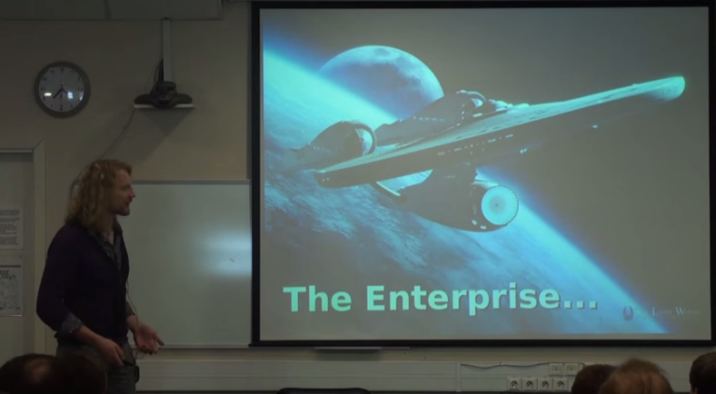
Alternative view on JEE and Architecture
Pure Simple Java (Антон Кекс - Как нам спасти Java?)
http://www.youtube.com/watch?v=TSAlj04_tkA
Notes:
youtube

